Slide 1
UTILITY SUMMIT
Delaware Department of Transportation and US Department of Transportation Federal Highway Administration
February 24, 2020
Notes:
What we present applies to DelDOT work AND work performed for municipalities or private work within the public ROW. There may be a utility permit issued that impacts municipal PAR’s but impacts a DelDOT roadway.

Slide 2
When Does This Apply?
The information in this presentation applies to:
DelDOT work
Work performed for municipalities
Private work within the public ROW
Some utility work impacts municipal PARs but impacts a DelDOT roadway.

Slide 3
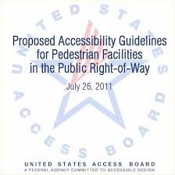
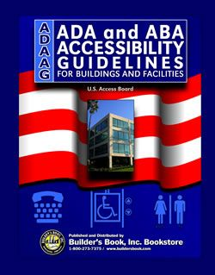
ADA Guidelines & Standards
PAS – Standards used to design, construct, and maintain pedestrian facilities within and along streets and highways under DelDOT’s jurisdiction
PROWAG – Proposed accessibility guidelines for the design, construction, and alteration of pedestrian facilities in the public right-of-way.
ADAAG - Scoping and technical requirements for accessibility to buildings and facilities covered under Title II and Title III by individuals with disabilities under the Americans with Disabilities Act
Notes:
It is in the public interest for utility facilities to jointly use the right-of-way when such use and occupancy does not have adverse effects.
PAS is most important in Delaware and ROW where DelDOT has jurisdiction, PROWAG is federal guidelines in ROW, and ADAAG is important but for sites and facilities so not where DelDOT cares.

Slide 4
Who is Responsible for ADA
This individual works for the utility company. Their responsibility is anything involving ADA, including ensuring their crews/contractors are following ADA standards at the site of the utility work, proper ADA training for employees, and review of utility plans.
This individual works for DelDOT. Their responsibility is to inspect the utility work and cite any ADA standards that are non-compliant at the site of the utility work.
We all are Responsible for ADA!

Slide 5
How is ADA Addressed in Permits
Permitting Design Requirements:
Design must comply with ADA
“The location of utility facilities and appurtenances shall be in accordance with the Americans With Disabilities Act.”
Design for utilities along partial-access-control highways must comply with ADA
“Lateral Positioning: In curbed sections, the utilities will be located as far as possible behind the curbs-and in compliance with the ADA.”
Pedestrian access must be maintained during performance of work
Notes:
These sections come from the Delaware Utilities Manual.

Slide 6
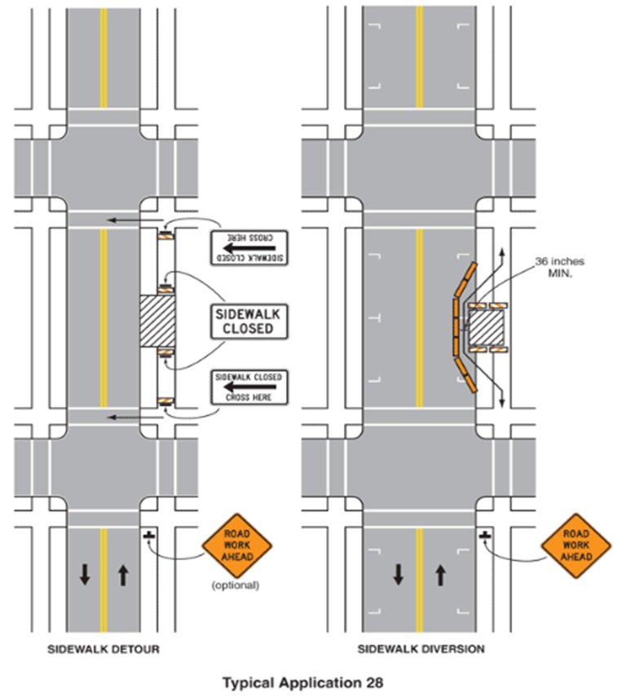
Traffic Control During Construction
Pedestrian routes around worksites are covered by the accessibility requirements of the Americans with Disabilities Act (ADA) of 1990.
Considerations:
Continuity of accessible paths for pedestrians.
Access to transit stops should be maintained.
A firm, stable, continuous surface throughout the entire length of the temporary pedestrian facility.
No vertical differences greater than 1/4 inch

Slide 7
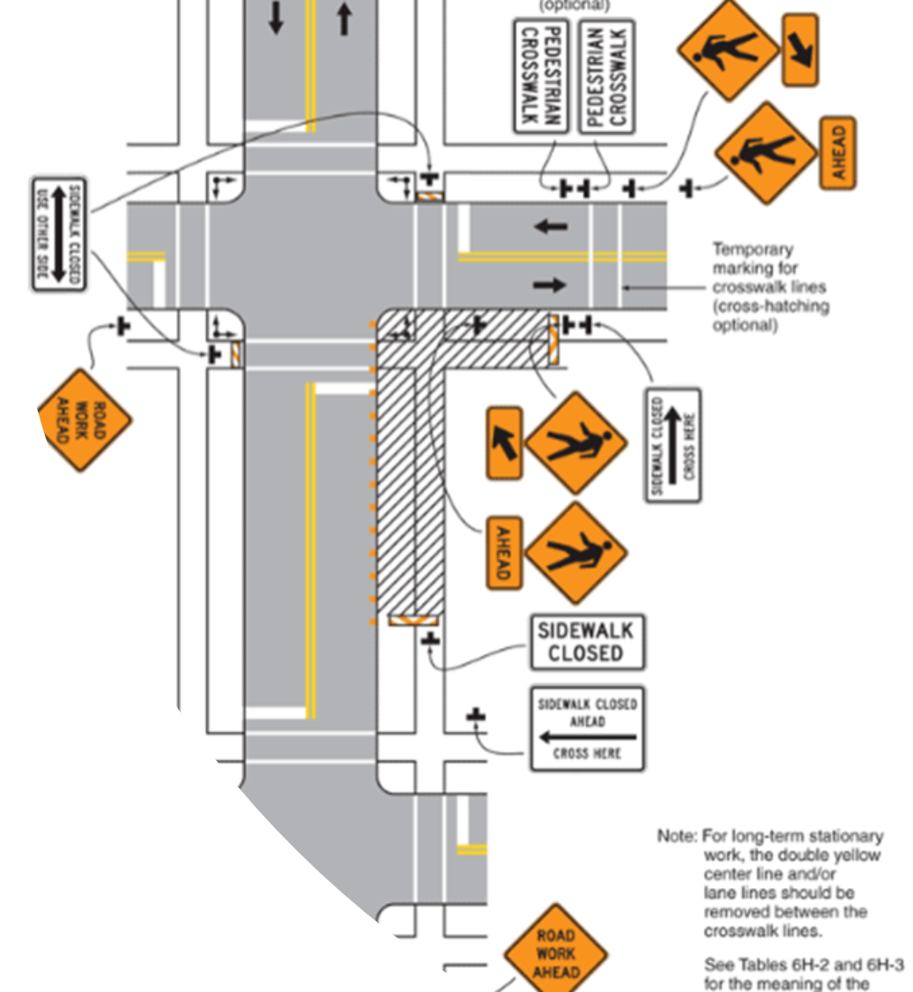
Traffic Control During Construction
Considerations (Continued):
The width of the existing pedestrian facility shall be provided for the temporary facility if practical.
Information about blocked routes and alternate crossings shall be communicated to pedestrians with visual disabilities by providing devices such as audible devices, accessible signals, and detectable barriers.
Signs and other devices mounted lower than 7 feet above the temporary pedestrian pathway shall not project more than 4 inches into accessible pedestrian facilities.

Slide 8
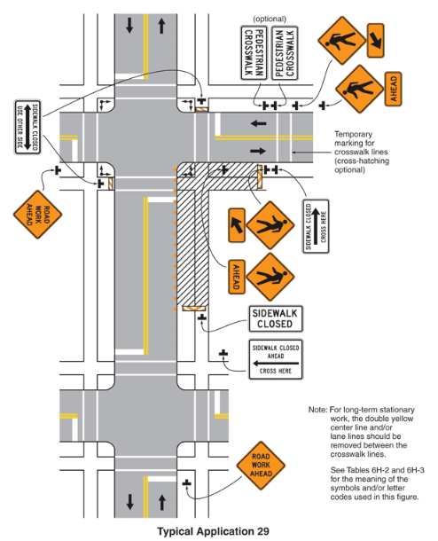
Typical Application 28 and 29 in the DE MUTCD show pedestrian MOT
Notes:
Typical Applications for Pedestrian Control during construction.

Slide 9
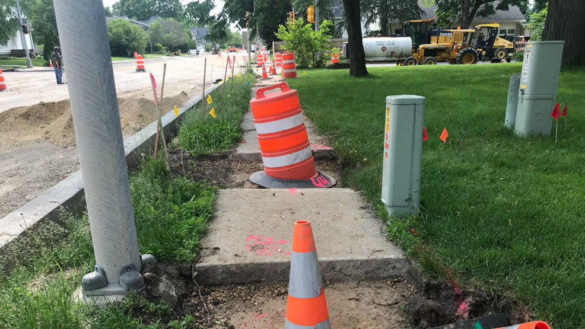
Sidewalk Repair
During Construction:
A firm and stable surface shall be provided throughout the entire length of the temporary pedestrian facility.
There shall be no vertical differences greater than 1/4 inch.
The geometry and alignment of the facility shall meet all applicable ADA requirements.
After Construction:
Damage to pedestrian features caused by utility installations or repairs must be restored to a condition at least equivalent to that which existed prior to the utility work before opening the facility to pedestrian use.

Slide 10
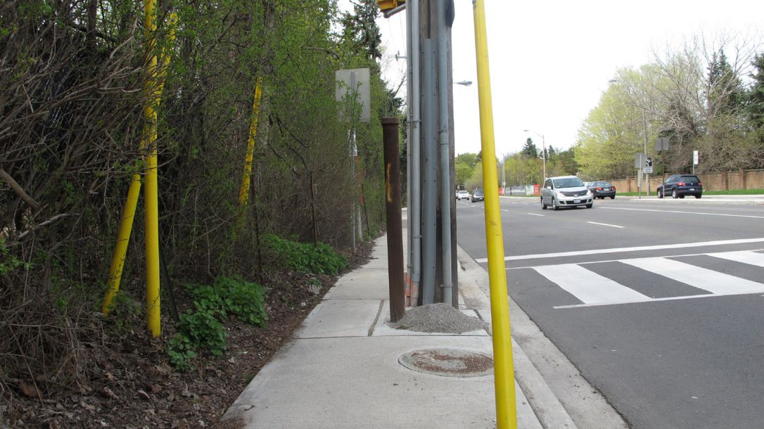
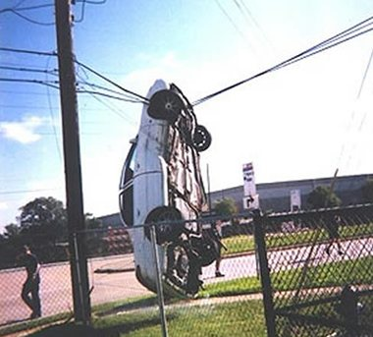
Utility Facility Design Criteria
Vertical Clearance
Protruding Objects
Utility Covers
Pedestrian Access Route (PAR) Width

Slide 11
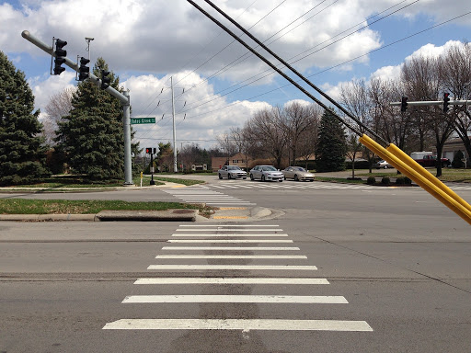
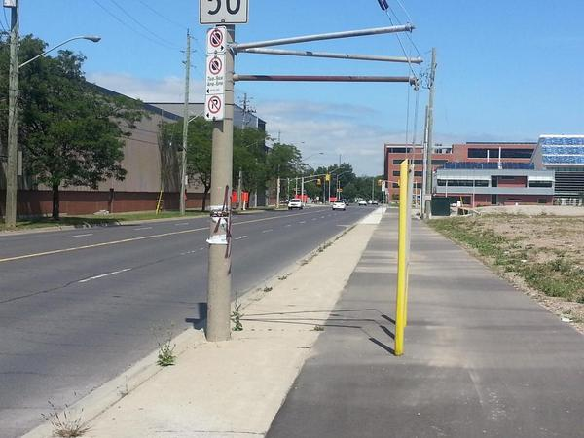
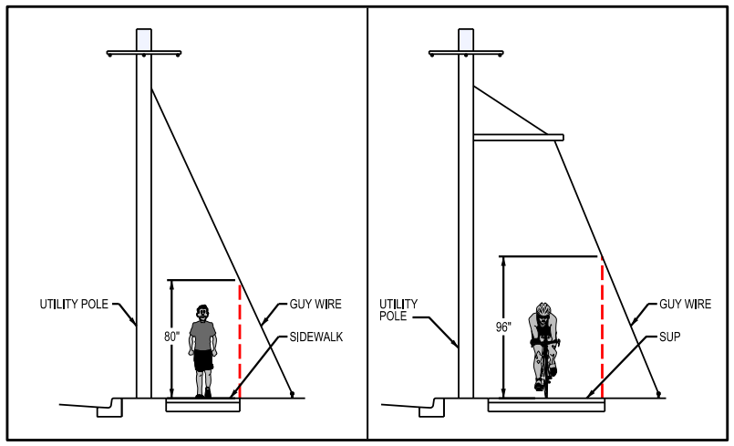
Vertical Clearance
Objects that protrude overhead can pose an issue for pedestrians trying to travel on a continuous, unobstructed path.
The Minimum Standard for vertical clearance under general obstructions is 80 inches above the PAR surface
The Minimum Standard for vertical clearance along a shared use path is increased to 96 inches.
Notes:
The two animated images are for poor vertical clearance.

Slide 12
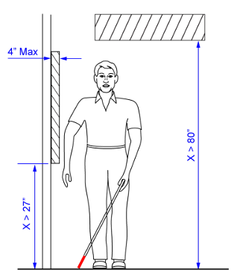
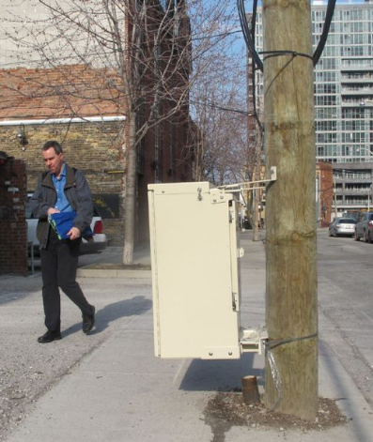
Objects in the PAR
PAS Standards:
New aboveground utilities are located behind the sidewalk, where right-of-way and/or easements are available.
If objects must be in the sidewalk, utilities should be placed to either right or left of center to provide a consistent utility corridor.
If utility features in the pedestrian route protrude above the cane detectable range (above 27”) and below required vertical clearance (below 80”), they must only protrude 4” maximum into the route.
Notes:
The placement of utilities can impact a coherent and continuous PAR corridor. In many circumstances, the designer is challenged with finding locations outside of the PAR for utility poles. Physical objects such as utility poles that are not relocated or redesigned and protrude into or obstruct the PAR reduce the effective width of the PAR and create challenges for persons with disabilities, especially persons with visual impairments.

Slide 13
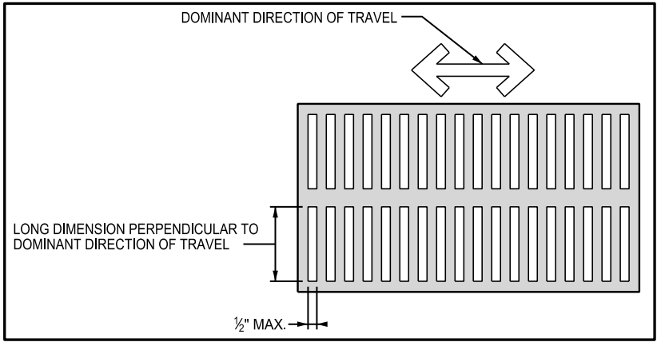
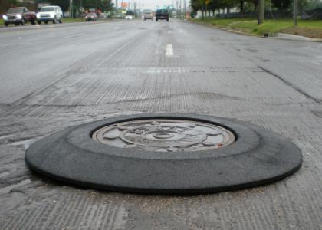
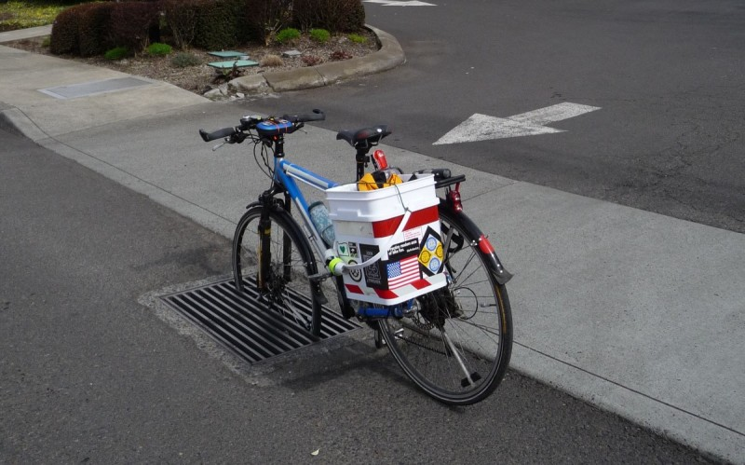
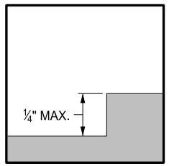
Utility Covers
Designs should locate surface utility-covers where they will not conflict with crosswalks, blended transitions, or curb ramps.
Utility covers and grates in a pedestrian route shall be skid resistant and comply with vertical surface discontinuity criteria and horizontal gap criteria.
Notes:
Utility covers located in the PAR pose compliance challenges. Where practical, designers shall first pursue relocation of the PAR or utilities to avoid the challenges created for users.
Vertical differences cannot be >1/4” & Horizontal gaps cannot be greater than 1/2”

Slide 14
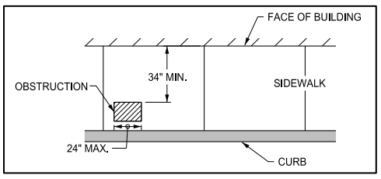
PAR Width
PAS Standards:
The desired width for a pedestrian feature is 5’ (The minimum width is 4’).
Pinch points cannot be less than 34” in width and 24” in length measured in the direction of travel.
PROWAG Guideline:
The minimum width of a pedestrian feature is 4’
ADAAG Standards:
The minimum width of a pedestrian feature is 3’
Notes:
Pinch points are not allowed in new construction.

Slide 15
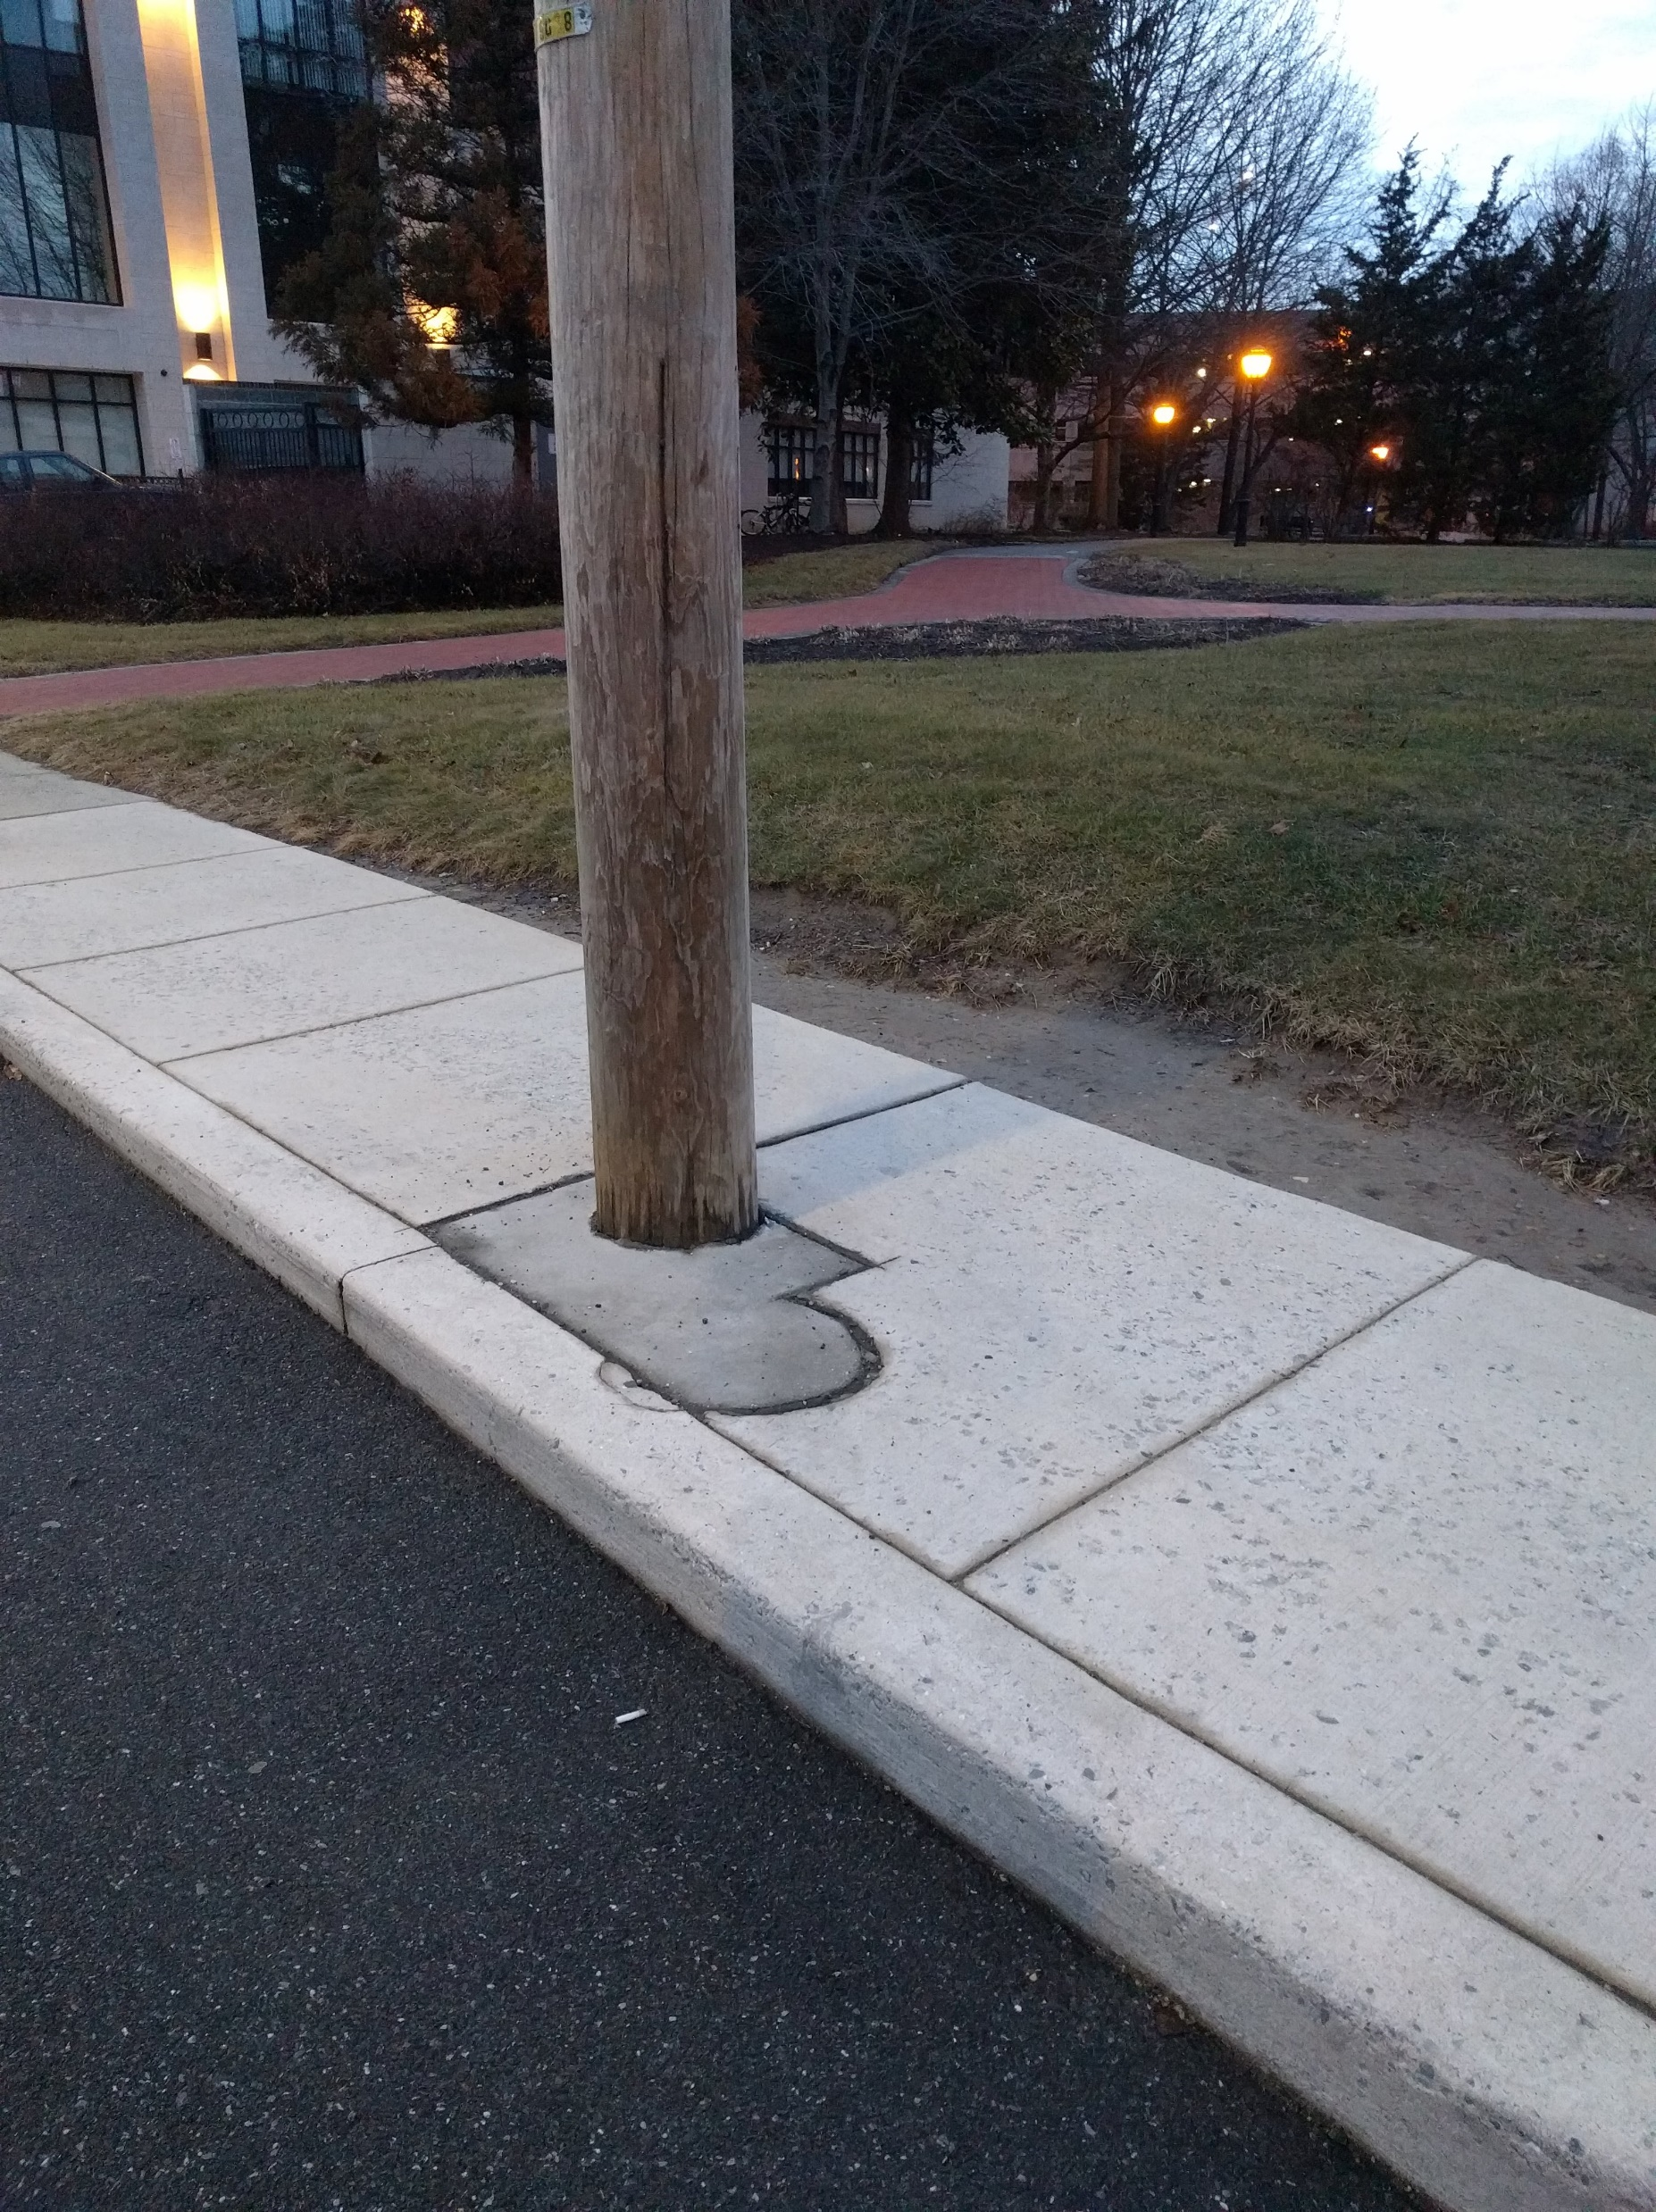
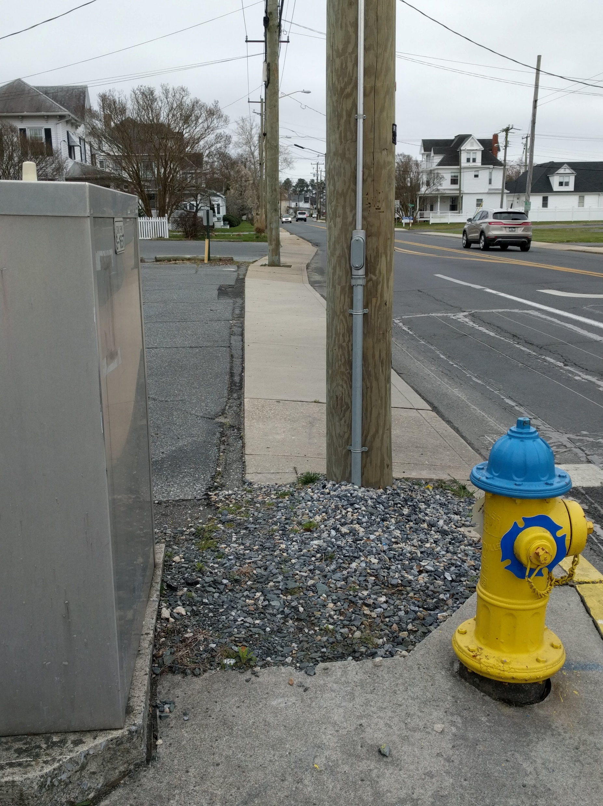
Pole Replacement
At minimum, the existing width must be maintained.
Relocation out of the PAR should be evaluated and if possible, it should be performed.
A firm and stable surface must be provided after the work is complete.
Notes:
The main thing an inspector is looking for is that a negative impact was not created. In the photo on the left and middle, the sidewalk is narrowed. On the photo on the right, the entire sidewalk is blocked.

Slide 16
State of Delaware Department of Transportation
Office of External Civil Rights
Todd Webb, ADA Title II Coordinator
Phone: 302.760.2048
800 Bay Road • Dover, DE 19901
Phone: 302.760.2035 Fax: 302.739.2254
civilrights.deldot.gov
U.S. Department of Transportation
Federal Highway Administration
Patrick Kennedy
1201 College Park Drive, Suite 102
Dover, DE 19904
Phone: 302.734.5326
Patrick.Kennedy@DOT.GOV

