Slide 1
Permitting
2020 utility summit - February 25, 2020

Slide 2
Complete & Clear Submissions
The better this is done, the easier it is to review and process permit submissions
Missing information will require additional follow-up and will delay the process
This includes good, detailed work description

Slide 3
Permit Submission Requirements
See Chapter 3 of the Utilities Manual for Design Requirements
Companies need to take these requirements into consideration during evaluation of proposed work
Additional information can be found in Chapter 4 of the Utilities Manual
https://deldot.gov/Business/drc/manuals/utilities_manual_2008_may_5.pdf?cache=1582079528259

Slide 4
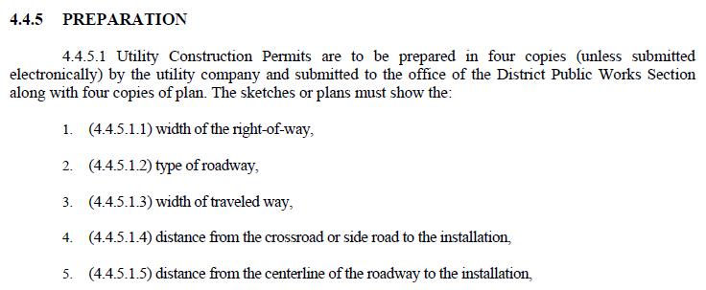
Permit Submission Checklist

Slide 5
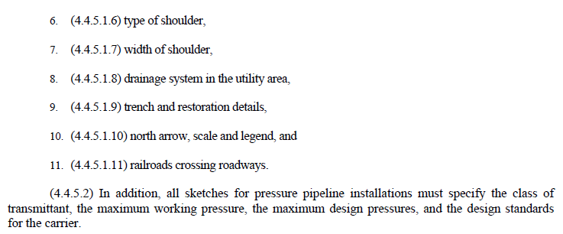
Permit Submission Checklist (cont.)

Slide 6
Permit Submission Checklist (cont.)
Additional Items
Location of work
Description of work (Be detailed)
Dimensions of the project
Supporting documents
Checklists help to provide consistency. We will likely create a more formalized submission checklist moving forward.

Slide 7
What should my plans/document look like???

Slide 8
Single site location

Slide 9
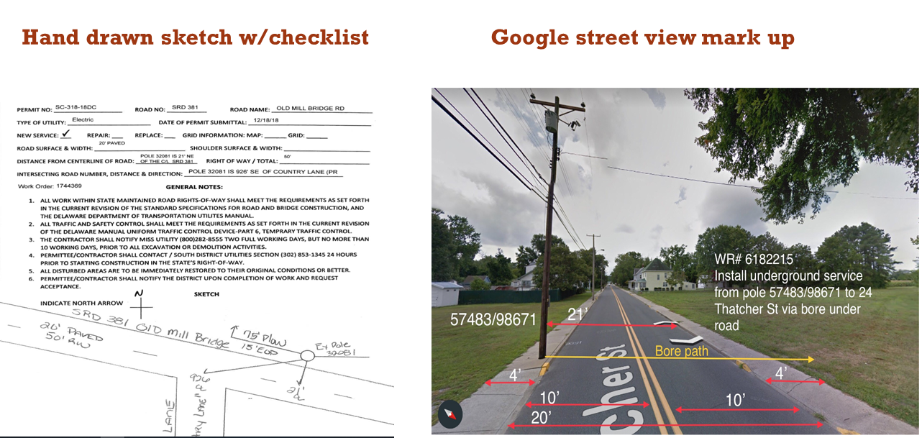
Sketch ideas for small projects

Slide 10
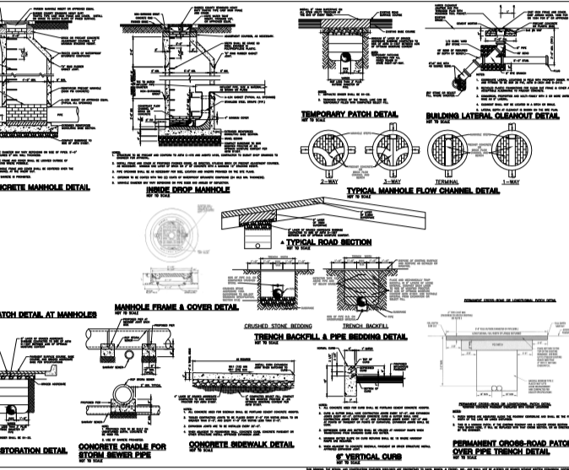
Larger projects
If the project involves a significant amount of open cutting or impacts the drainage (open or closed), sidewalks/ADA ramps, pavement restoration, lane reconfiguration, etc., then a full set of plans need to be submitted.
Hard copy plans need to be submitted to Public Works for these projects.

Slide 11
Casings
See Chapter 3.6.4 for current requirements
Companies responsible for proper design of casing, This shall include material type, class, thickness, etc.

Slide 12
Mot & lane closure restrictions
Day work vs. night work
Safety concerns
Waiver requests
MOT reviews
Work over live traffic
DelDOT currently working to put an MOT training session together for utility companies. More to follow.

Slide 13
Notification of work
Need notification from utility prior to work starting
Weekend work notification
Company to notify DelDOT when all work associated with permit is complete

Slide 14
restoration
Restoration needs to be performed in accordance with the Utility Manual and DelDOT Standard Construction Details
Restoration should not lag too far behind installation
Lack of restoration can cause delay on other permit projects

Slide 15
Management of permit work
Means & Methods
Tracking of Work & Restoration
Utility Company Inspection of Work

Slide 16
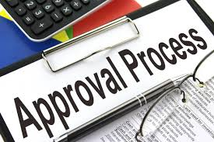
Permit approval timeframes
14 calendar days for standard & small projects
Larger projects will take longer

Slide 17
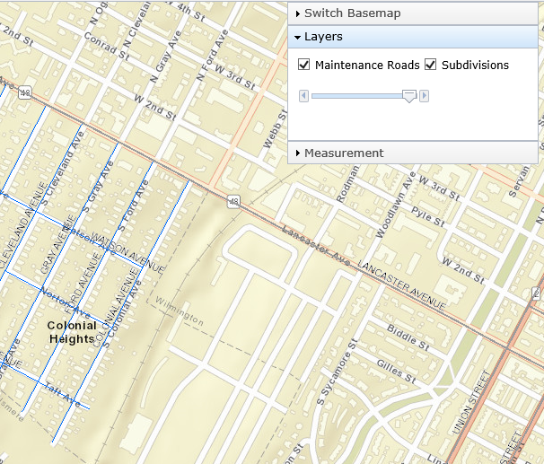
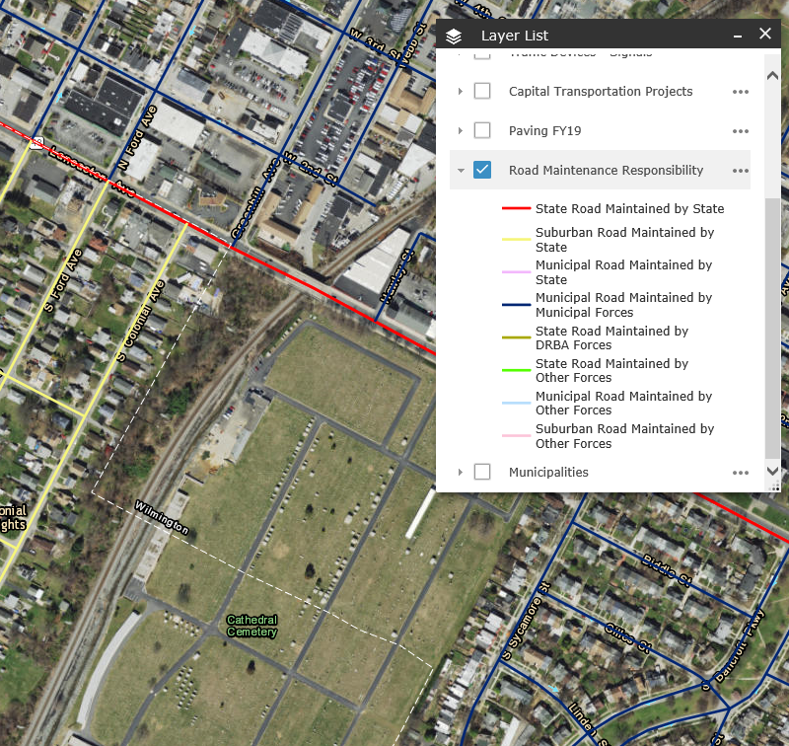
State maintenance responsibilities
UPA Map has layers that help identify which roads are state maintained
Gray & blue lines indicate state maintained roads.
DelDOT also has a map that could be used for guidance
http://deldot.maps.arcgis.com/apps/webappviewer/index.html?id=d23426ad5f2c4bc7a48ba8806302d179

Slide 18
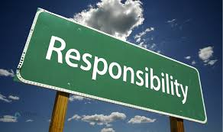
Who is responsible for permit
Contractor Performing the Work?
Developer?
Utility Company?
The Franchised utility company is the entity with the authority to install, own, operate and maintain utility facilities within the right-of-way so they are responsible for their permits.

Slide 19
Holding of Permits
Holding of permits is one of the only enforcement mechanisms DelDOT has to ensure things are done properly, whether situation is related to a highway project or permit work.

Slide 20
Other permitting discussion items

Slide 21
Thank you!

