Slide 1
DelDOT Program Forecast & Policy Update
Utility Summit 02/25/2020

Slide 2
Excellence in Transportation Every Trip. Every Mode. Every Dollar. Everyone.
Every Trip
We strive to make every trip taken in Delaware safe, reliable and convenient for people and commerce.
Every Mode
We provide safe choices for travelers in Delaware to access roads, rails, buses, airways, waterways, bike trails, and walking paths.
Every Dollar
We seek the best value for every dollar spent for the benefit of all.
Everyone
We engage and communicate with our customers and employees openly and respectfully as we deliver our services.

Slide 3
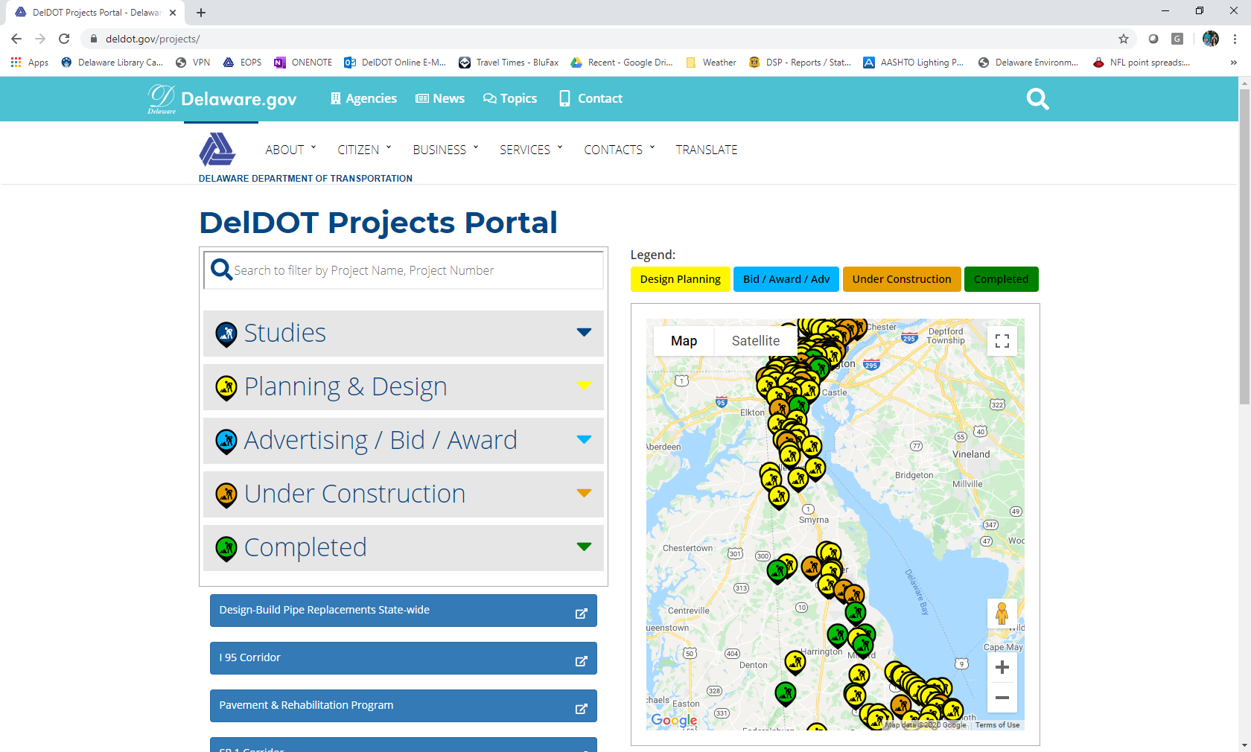
Project Updates
Corridor Approach
www.deldot.gov/projects

Slide 4
Notes:
Strategy for Major Corridors: This will be captured in the update to the DelDOT Long Range Transportation Plan
Red – Capacity Improvements and Congestion mitigation
Yellow – Conversion to controlled-access, capacity preservation
Black – Operational improvements for safety and multi-modal solutions

Slide 5
New Castle County

Slide 6
I-95 Rehabilitation project
Extends from I-495 / I-95 split to US 202 (Concord Pike)
Rehabilitation of 19 bridges
Rehabilitation of over 3 miles of pavement
Reconstruction of 11 exit / entrance ramps
Elimination of S. Jackson Street ramp to I-95 SB
New 2nd Street on-ramp to I-95 SB
CM/GC – Kiewit
Advanced projects wrapping up in 2020
Break-out projects
Mainline construction scheduled to start in March 2021

Slide 7
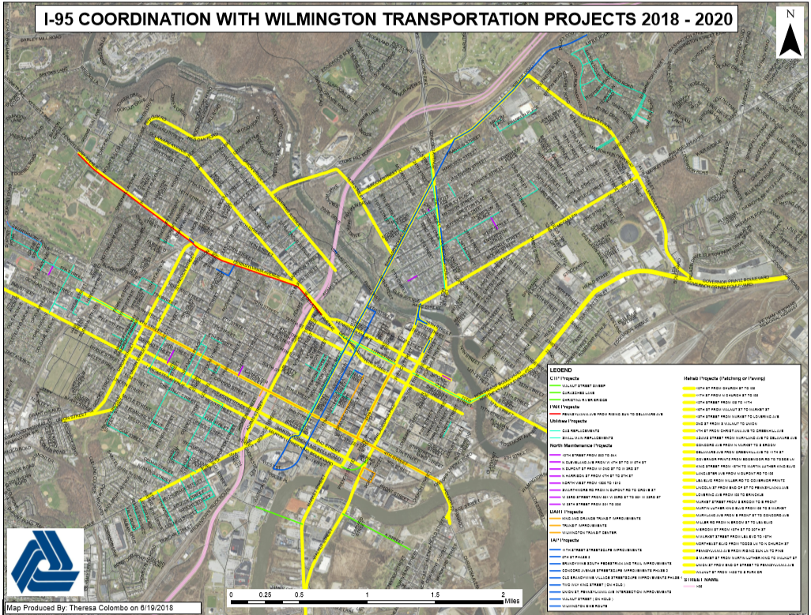
Notes:
We are now up to 53 paving and patching locations in the City as mitigation efforts for the I-95 Rehabilitation from I-495 to North of the Brandywine River Bridge.
The 11th Street Contract will be advertised shortly. We will look to add locations to this contract and existing contracts in order to get the work going.
The game plan is to perform this work over the 2019 and 2020 construction seasons.

Slide 8
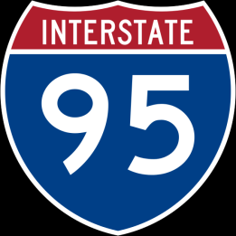
US 202 Interchange
Carr & Marsh Rds Interchange
I-95 from I-495 to North of Brandywine River Bridge
SR 141 Interchange
I-495 SB Merge
SR 1 Interchange
BR 1-717
I-295, SR 141 to US 13
5th Lane Widening
SR 896 Interchange
SR 273 Interchange
Planned
Project Development Phase
High Speed
E-ZPass Lanes
Construction Phase
Completed
Notes:
SR 141 Ramps G & F – Construction substantially complete.
SR 141, I-95 Interchange to Jay Drive – Construction started this past Summer; Complete Spring 2022. Significant work on 95 and 95 ramps done before Viaduct.
I-95 Rehabilitation from I-495 to North of the Brandywine River Bridge– in design now; Construction start Spring 2021
Pre-requisite Projects: Walnut Street Sweep, Double Left on 12th street to Northeast Blvd, I-95 Carr Rd & Marsh Rd, CRB & approaches – goal to be open before I-95 Rehab starts
CM/GC Project – Awarded to Kiewit. Considering ways to make the project go faster, less impact to traffic, maybe advanced work in 2020.
I-95 Carr Road & Marsh Rd – Project Awarded to Greggo & Ferrara in October 2018; Complete Summer 2020
Christina River Bridge: Both in construction now.
Bridge – Construction started June 2017; Completed Fall 2019
Approach Roadways – Construction start Fall 2018; Complete Summer 2020
Newark Train Station:
Parking Lot & Access Road – Construction started June 2017; Substantially complete – Final Inspection scheduled for December 2018.
Station Building & Track A – Construction started July 2018; Completion early 2020
I-95, SR 896 Interchange – Preliminary design phase is underway. CTP shows construction in FY25 but we will pursue grants to go earlier, if possible
I-295, 141 to 13. Engineering to start in FY23 per CTP. Traffic analysis complete and concept design underway. Starting to look for ways to advance this project sooner.

Slide 9
1
New Castle County
SR 1 Widening
2 to 3 Lanes
SR 1 & SR 273 Interchange
SR 1 SB Auxiliary Lane
SR 1 NB Auxiliary Lane
SR 1 & 40 Interchange
SR 1 @ Tybouts Interchange
SR 1 Widening
3 to 4 lanes
Diverging Diamond Interchange
Planned
Project Development Phase
Construction Phase
Completed
Notes:
SR 1 NB Auxiliary lane was a big success. It reduced morning congestion by 40%. = low cost high value project
SR 72 DDI – Complete
SR 1 Widening – still working through the environmental process for the overall widening project.
SR 1 SB Aux Lane – Currently designing a new auxiliary lane from SR 273 to US 40 – we anticipate it will help reduce congestion until the full widening project can move forward.

Slide 10
Rehab of Centre Rd
141
Tyler McConnell Bridge
SR 141, I-95 to Jay Drive
I-95/SR 141
Ramps G & F
Planned
Bridge 1-680
Construction Phase
Completed
Notes:
SR 141 Ramps G & F – Construction substantially complete.
SR 141, I-95 Interchange to Jay Drive – Construction start Summer 2019; Complete Summer 2021
Rehab of Centre Road – Reopened in November; Construction completed Spring 2019
Tyler McConell – PE scheduled for FY23

Slide 11
273
SR 273 & Red Mill Rd Connector
SR 273 &
I-95 Ramp
SR 273 & Chapman Rd
Project Development Phase
Construction Phase
SR 273 , Appleby Rd to Airport Rd
Completed
Notes:
SR 273, Appleby Rd to Airport Road – under construction. Expected completion fall 2020.
SR 273/Red Mill – C Spring 2019. Complete fall 2019.
SR 273/I-95 Ramp – Field work and preliminary design underway; C Fall 2020 through Fall 2021
SR 273/Chapman – Design is underway. Construction planned Fall 2020 through Spring/Summer 2021

Slide 12
40
US 40 & SR 1 Interchange
US 40
Widening, Salem Church to Walther
US 40 & SR 7 Intersection
US 40 & SR 7 Interchange
US 40 & SR 72 Intersection
US 40 & SR 896 Interchange
Planned
Project Development Phase
Construction Phase
Completed
Notes:
US 40/SR 896 – In design. Construction scheduled for FY23.
US 40/SR 72 Intersection Improvements – Construction is underway – scheduled to be complete in fall 2020.
US 40 Widening, Salem Church Road to Walther Road – adds an additional lane; design underway. Workshop in 2020. Const scheduled for 2023.
US 40/SR 1 – Part of SR 1 widening project; No action underway yet.
US 40 / SR 7 – peds, lane modifications – substantially complete.
US 40 / SR 7 Interchange - scheduled to start PE in FY 23.

Slide 13
Kent County

Slide 14
13
Kent County
US 13 Widening, Lochmeath Way to Puncheon Run
Camden Bypass (West)
Camden Bypass (East)
Project Development Phase
Construction Phase
US 13 Widening, Walnut Shade to Lochmeath Way
Completed
Walnut Shade Road, US 13 to Peach Tree Run
Notes:
US 13 Widening (Lochmeath to Puncheon Run) – Semi-final Design is underway; Construction 2022-2025.
US 13 Widening (Walnut Shade Rd to Lochmeath) – Preliminary Design is underway; Construction 2023-2026.
Camden Bypass – preferred alternative selected. In design. Construction scheduled for 2023-2025.
Walnut Shade – roundabout at Peach Tree and multi-modal path, 13 to Peach Tree. In design. Workshop winter 2019/2020. Construction 2023-2024.

Slide 15
8
Kenton Road
SR 8 @ Saulsbury Road
Dover High School
Pearsons Corner
SR 8 Connector
POW-MIA Parkway
Planned
Project Development Phase
Completed
Notes:
POW-MIA Parkway - anticipated completion Summer 2017
SR 8/SR 15 – Safety project; design ongoing. Construction 2021-2022.
SR 8 Connector – not scheduled yet. PE scheduled for FY21.
Kenton Road in design. Construction could potentially begin as early as 2022, but is currently in the CTP as FY26.

Slide 16
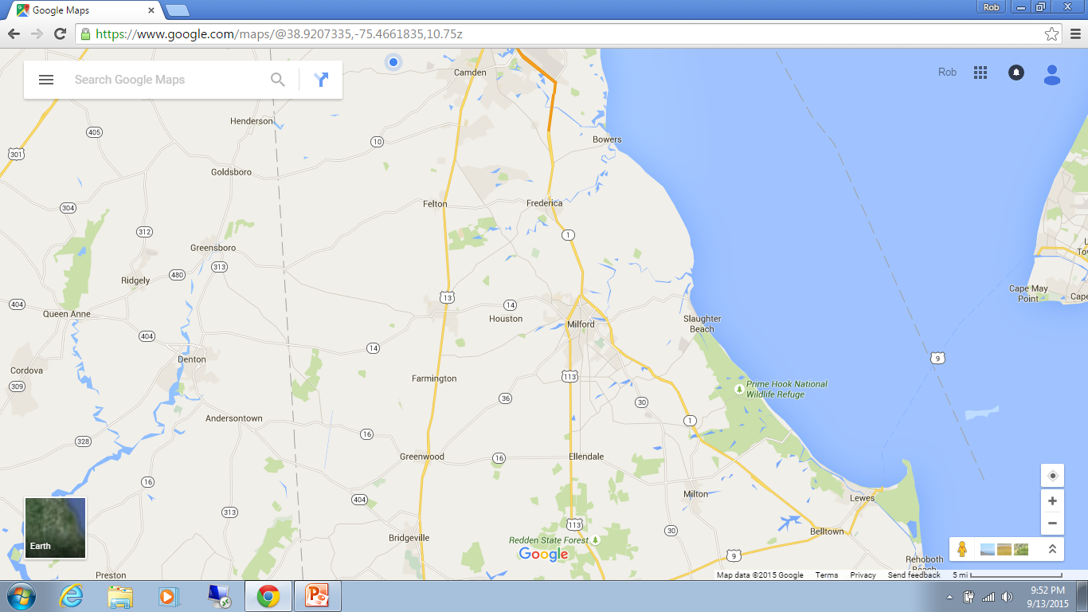
1
SR 1 @ SR 9 DAFB
Kent & Sussex Counties
SR 1 @ Little Heaven
SR 1 @ North Frederica
SR 1 @ South Frederica
SR 1 @ Thompsonville Rd
NE Front St., Rehoboth Blvd to SR 1
SR 1 @ NE Front St.
SR 1 @ SR 30
Planned
Project Development Phase
SR 1 @ SR 16
Construction Phase
SR 1 @ Cave Neck
SR 1 @ Minos-Conaway
Completed
SR 1 @ Five Points
Notes:
SR 1, Little Heaven – substantially complete summer 2019
SR 1, South Frederica – Substantially completed October 2018
SR 1, N.E. Front St. – substantially complete summer 2019
SR 1, SR 16 – design and r/w acquisition is underway; Anticipate construction 2021 - 2024
SR 1, Minos-Conaway – Preliminary Design is underway. Good workshop in Oct. 2019. Const. Scheduled 2023-2025.
SR 1, Cave Neck – Preliminary Design work underway, but also exploring a P3 option with the developer. Path forward TBD. Construction schedule 2024-2025.
SR 1, Five Points – Planning study – working on implementation of many recommendations.

Slide 17
Sussex County

Slide 18
113
US 113/SR 16 GSI
US 113/Redden Rd GSI
US 113/Wilson Rd GSI
US 113/SR 18/SR 404 GSI
US 113/US 9 GSI
US 113/Arrow Safety GSI
US 113/S. Bedford St GSI
US 113/Speedway/Kruger GSI
North Millsboro Bypass
US 113 Widening
Planned
Project Development Phase
Notes:
US 113 at SR 16 GSI – Conceptual design is underway. A public workshop will be held in the winter of 2019/2020 to present alternatives. Construction is currently funded for FY 2027.
US 113 at SR 18/404 GSI – Preliminary Design is underway; We are moving forward with Alternative B, which includes loop ramps on the northeast and southwest quadrants of the intersection. We will be holding meetings with property owners in the winter of 2019/2020. A second public workshop will be held in the winter of 2019/2020. Construction is anticipated to begin in 2024.
US 113 at US 9 GSI – PE in FY22
North Millsboro Bypass – Preliminary design is underway. Field survey is complete. ROW work 2021-2023; Construction is anticipated to begin in 2023.
US 113 Widening – PE in FY22

Slide 19
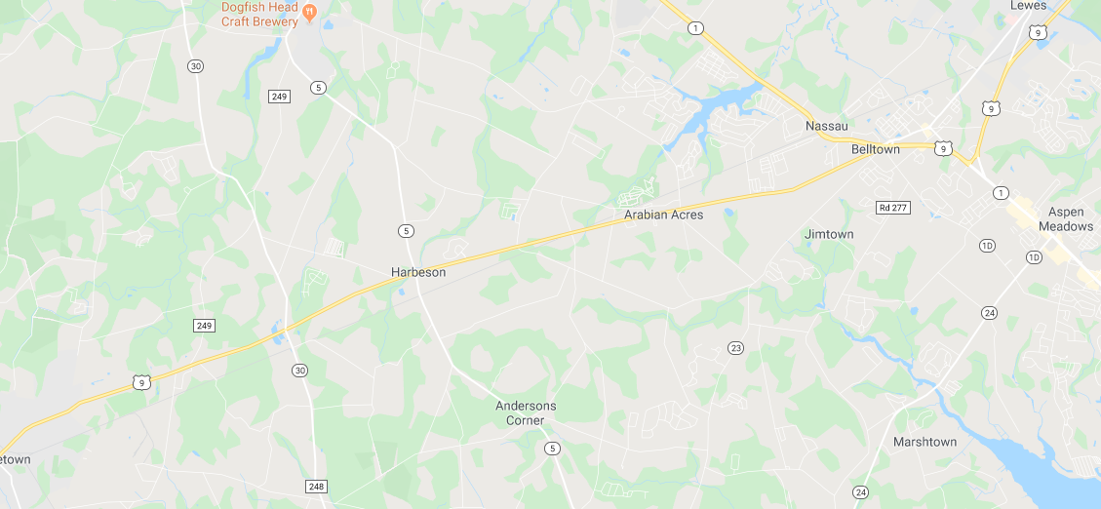
9
US 9 (Kings Hwy) – Dartmouth to Freeman
US 9 Widening
(Ward Ave to Old Vine Rd)
US 9 @ Dairy Farm
US 9 @ Minos Conaway
US 9 @ Hudson & Fisher
US 9 @ SR 5
US 9 @ Park Ave
US 9 @ SR 30
Planned
Project Development Phase
Georgetown East Gateway
Construction Phase
Completed
Notes:
Georgetown East Gateway (US 9/Sandhill/Airport Rd) – Final design and right of way acquisition are underway. Utility relocations will begin in the spring of 2020. Construction is anticipated to begin in the summer of 2020.
US 9 @ Park Ave – Part of Park Avenue Relocation Phase 2; Preliminary design is underway. Construction is anticipated to begin in 2023.
US 9 & SR 5 Intersection Improvements – Construction substantially complete in August 2019
US 9 & Minos Conaway - PE in FY22
US 9 Widening (Ward Ave to Old Vine Rd) – Will be added to the FY 21-26 CTP; PE FY24
US 9 (Kings Hwy), Dartmouth Drive to Freeman Hwy – PE in FY22

Slide 20
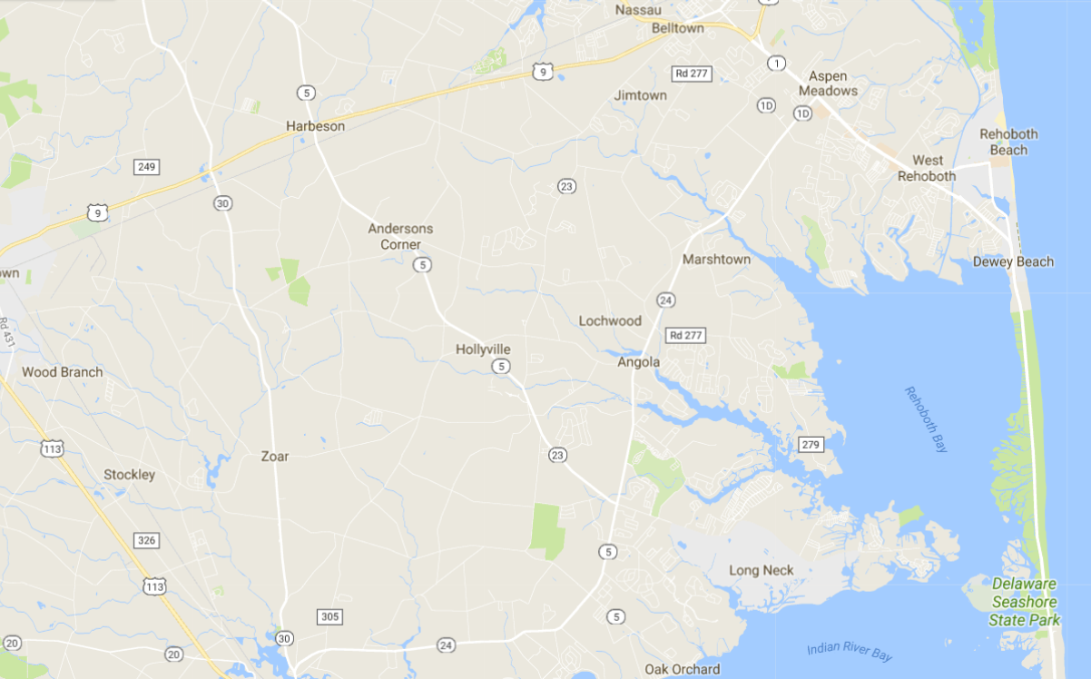
24
Plantation Road, Phase 1
Plantation Road, Phase 2
SR 24, Love Creek to Mulberry Knoll
SR 24, Mulberry Knoll to SR 1
SR 24 @ Camp Arrow Head
SR 24 @ Angola/Robinsonville
SR 24 @ Long Neck
SR 24 @ Bay Farm/Autumn
SR 24 @ Mount Joy
North Millsboro Bypass
Project Development Phase
Notes:
We have been strategizing a comprehensive approach to the construction coordination for these projects using a Master Scheduling approach. The timing of when each goes to construction may change from what is listed below pending the outcome of the master scheduling study. A liaison will be assigned to this corridor during construction to handle constituent concerns, just like we did on SR 26 and US 301.
SR 24 Mulberry Knoll to SR 1 – Advanced utilities to start in Fall 2019. Plan to award project in Dec. 2019. Construction to start in Spring 2020 and be complete in 2022.
SR 24, Love Creek to Mulberry Knoll – R/W acquisition has begun; Construction anticipated 2021 through 2022.
SR 24, Camp Arrow Head; SR 24, Angola/Robinsonville – ROW acquisition underway; Construction anticipated 2021 through 2022. Considering combining with other SR 24 intersection projects.
SR 24, Long Neck Road (SR 5 & SR 23) – ROW acquisition underway; Construction anticipated 2021 through 2022. Considering combining with other SR 24 intersection projects.
SR 24, Mount Joy; SR 24, Bay Farm – ROW acquisition underway. Construction possible in 2020 through 2022. Considering combining with other SR 24 intersection projects.
Plantation Phase 1 (US 9 to Robinsonville) – Construction anticipated 2022 – 2023.
Plantation Phase 2 (SR 24 to Robinsonville) – Construction TBD; Evaluating four lane section
North Millsboro Bypass - Preliminary design is underway. Field survey is complete. ROW work 2021-2023; Construction is anticipated to begin in 2023.

Slide 21
Planned Lane Restrictions and Road Closure Policy
Policy Implement C-09
Adopted in 2016; Updated version to be finalized shortly
Purpose: To establish a uniform approach to minimizing the traffic impacts resulting from construction and maintenance work occurring on the State’s roadways.
New requirement regarding documentation of duration of road closure in permit.
Key to success on large/complex projects: get in touch with us as early as possible in design to start sorting out lane closure restrictions, detours, necessary traffic analysis, time-frames, staging, etc.

Slide 22
Innovations in Design, Construction and Beyond
Accelerated Bridge Construction
Alternative Contracting
Early Right of Way Acquisition
Utility Coordination
e-Bidding
Stormwater Pollution Prevention Plan (SWPPP) App and Pilot
Cooperative Automated Transportation
Notes:
ABC: pre-cast deck panels, pre-cast bridges, pre-fab modular steel units, ultra high performance concrete
AC: D-B, Construction Manager / General Contractor (CM/GC), A+B, Incentives, Milestones, etc.
Earlier NEPA, earlier r/w – utility coordination will be important in this
Utilities: Coordinating Council, Review/response timeframes, contractor change approval process, tech solution for utility relocation status
E-bidding: fully implemented soon
SWPPP:
CAT: new section in DTC, autonomous shuttles, AI/machine learning, SPaT/RSUs

Slide 23
Thank You!
Mark Luszcz
Delaware Department of Transportation
Division of Transportation Solutions
Deputy Director (Design)
Mark.Luszcz@Delaware.gov
302-760-2356

