Slide 1
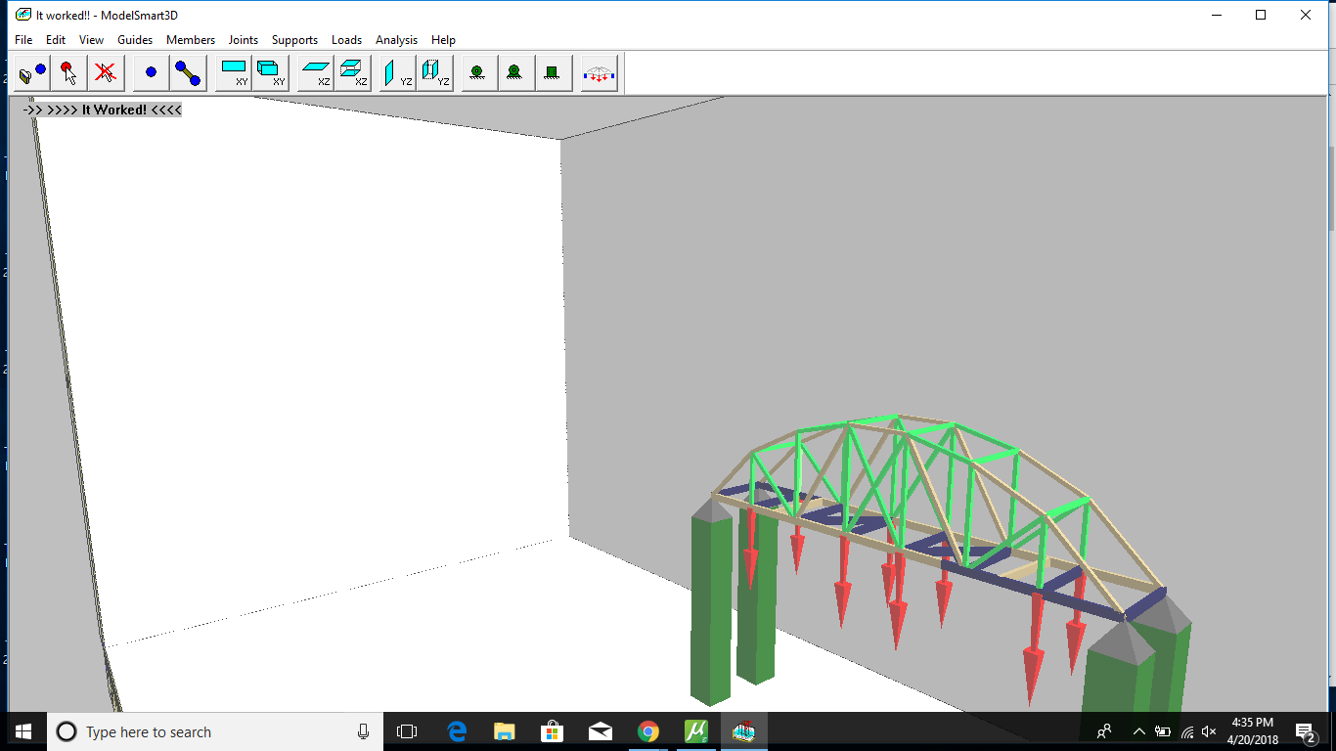
The Art of Bridge Design
Adam Hanna, Silvana Nasim, Nate Allen

Slide 2
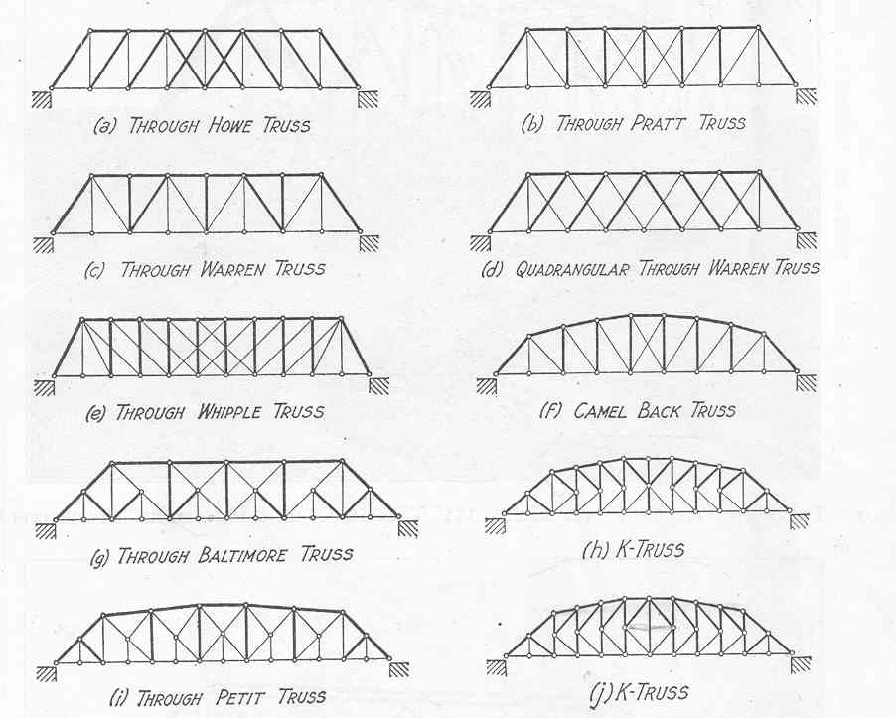
Design
We originally designed and tested a Warren bridge.
The bridge however, was too simplistic and did not carry an optimal amount of weight to be efficient.
We then decided to go with a modified Pennsylvania which involved an top arch design and held a substantial amount of weight.

Slide 3
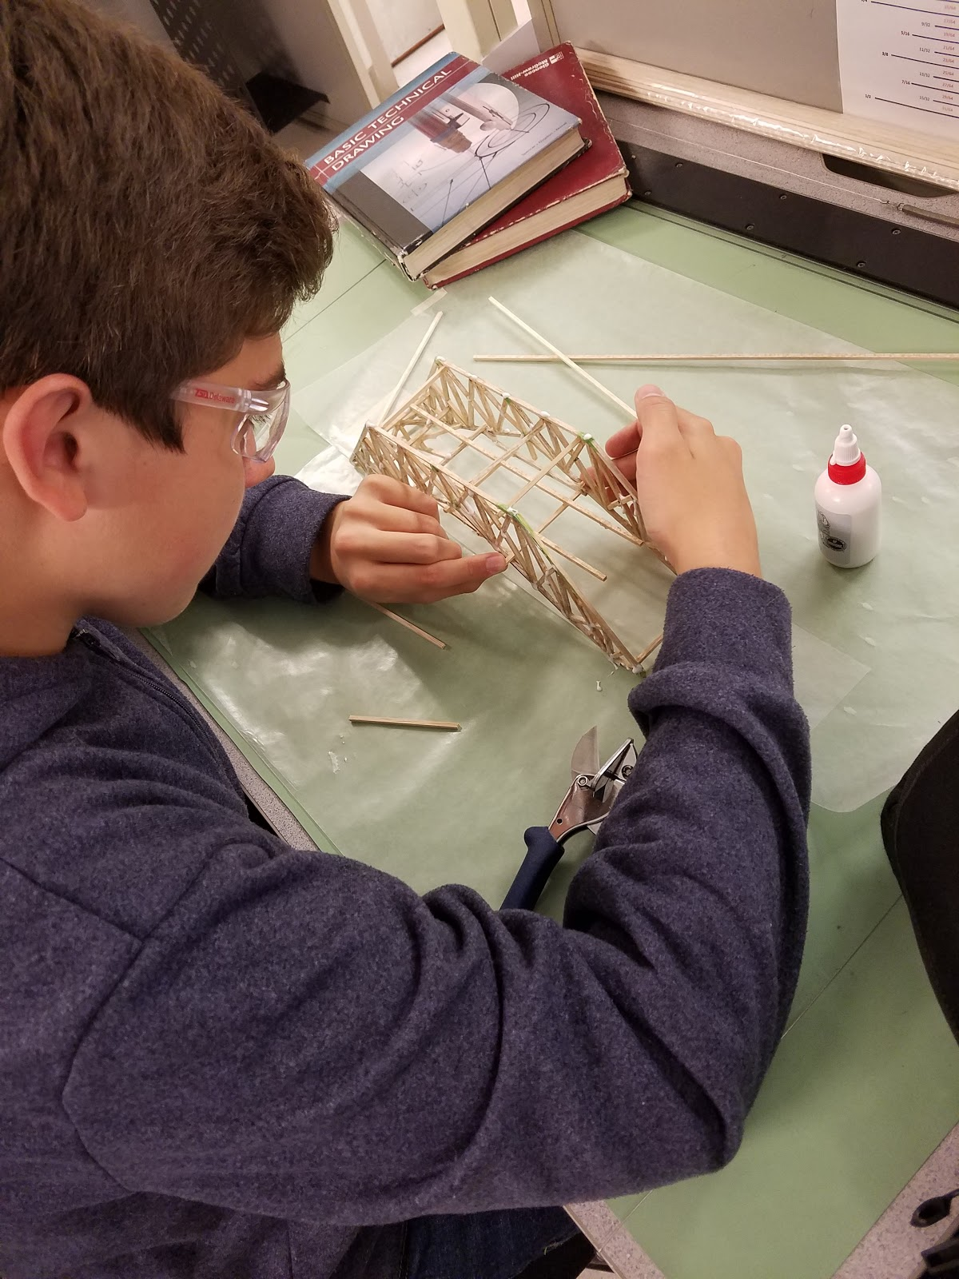
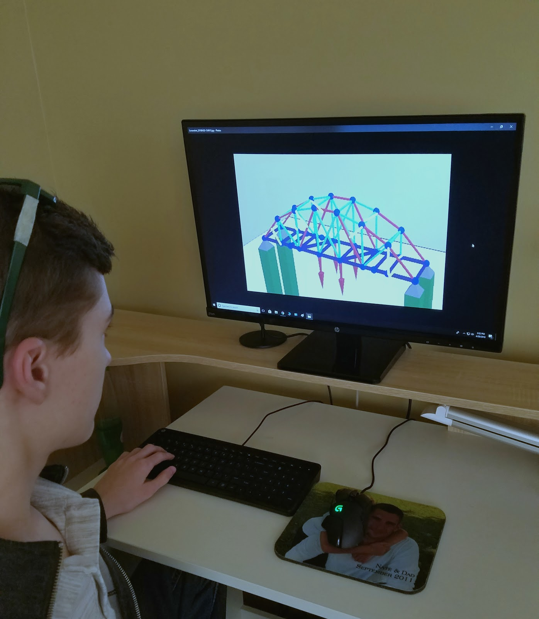
Cooperation
As a team people must learn to work together to achieve greatness.
We discussed problems and decided designs together.
The use of combining ideas was heavily involved in our team.
Flexibility is our framework.
Communication is key.

Slide 4
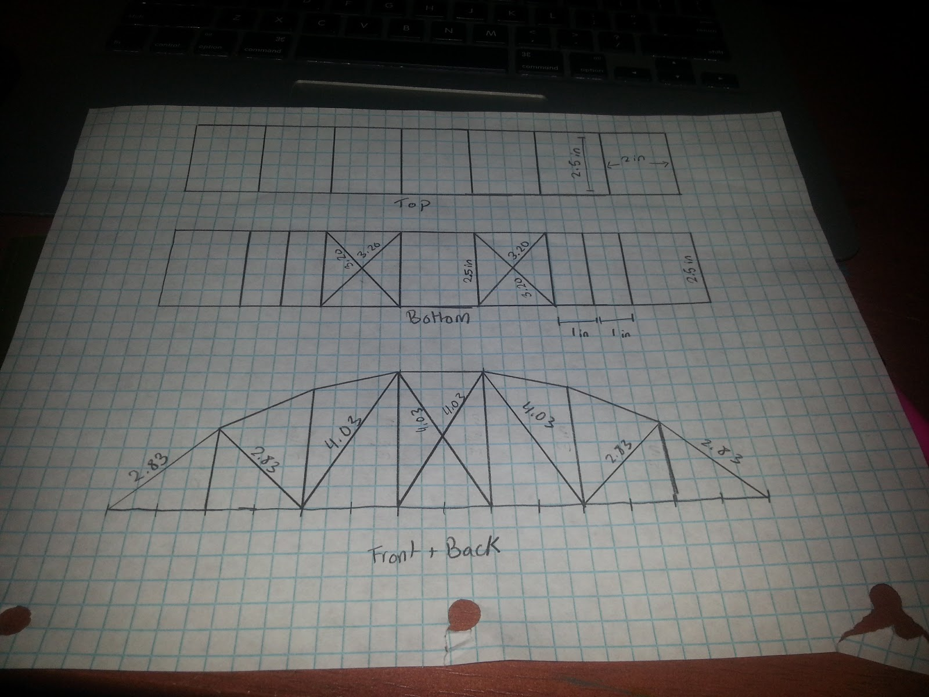
Process
First we gathered design ideas and picked one we as a group thought was worthy.
We modeled and tested multiple designs and later chose a better working bridge concept.
As a team, we organized and divided our work to get the most done efficiently.
Our current model and paper work were done in parallel to ensure productivity.

Slide 5
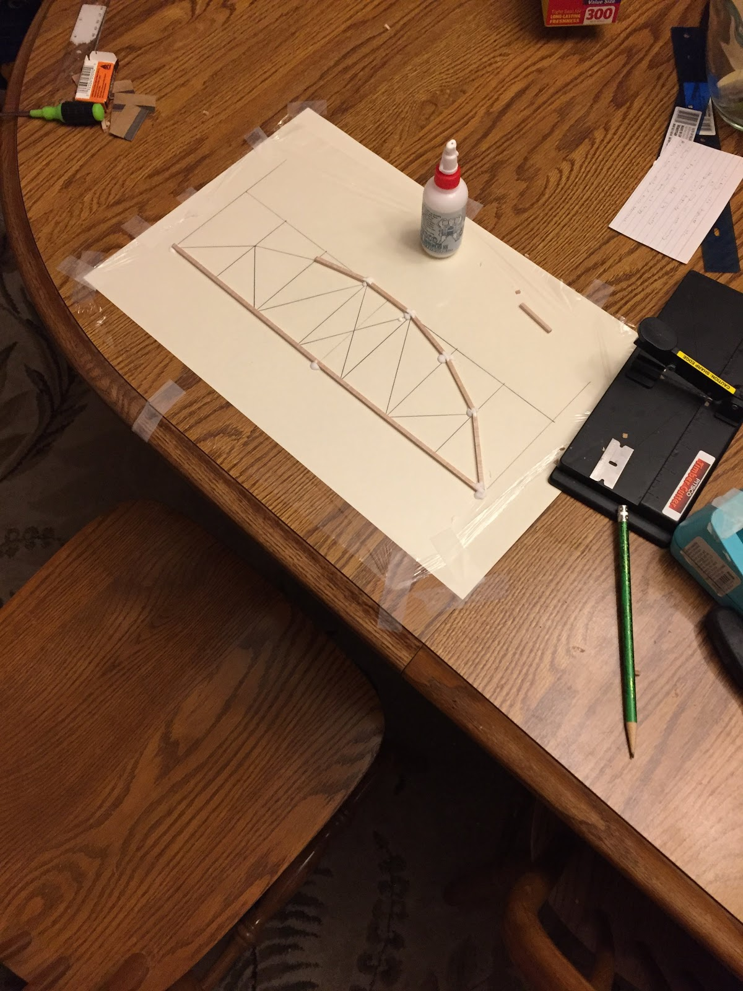
Lessoned Learned
The arch style on the Pennsylvania bridge is extremely supportive and effective.
Making a bridge shorter to allow less fluctuation in each beam
Cross beams are very effective in holding weight and supporting the bridge.
Managing time is a key factor in completing a well designed and planned bridge

Slide 6
Conclusion
Competitive spirit influenced us greatly and we strived to do our best to win the competition. However, as we progressed through the process, we discovered something more impactful. Through all the stress and difficulty, we saw the undeniable desire to not give up and keep going until we reached the point we wanted to be at. We discovered the fun in the designing and building of bridges and the want to learn more and more about the forces and science behind the effectiveness of these structures. Even if success does not shine in the future of our bridge, the skills and knowledge learned in our experience will influence us greatly and open up future possibilities.

